Slide 1
Select Option from Drop-Down Box
Use below link for drop down
https://demoqa.com/select-menu
Before handling dropdown in Selenium and controlling drop-down boxes, we must do following two things:
Import the package org.openqa.selenium.support.ui.Select
Instantiate the drop-down box as an object, Select in Selenium WebDriver
Import the “Select” package.
Declare the drop-down element as an instance of the Select class. In the example below, we named this instance as “drpCountry”.

Slide 2

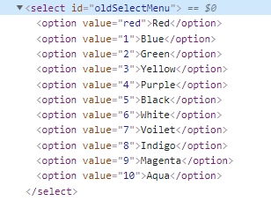
We can now start controlling “drpCountry” by using any of the available Select methods to select dropdown in Selenium. The sample code below will select the option “ANTARCTICA.”
Select color = new Select(driver.findElement(By.id("oldSelectMenu")));
color.selectByIndex(1);
color.selectByValue("5");
color.selectByVisibleText("Yellow");

Slide 3
Implicit, Explicit and Fluent Wait in Selenium WebDriver
Suppose we are trying to find an element which has some “ExpectedConditions “(Explicit Wait), If the element is not located within the time frame defined by the Explicit wait(10 Seconds), It will use the time frame defined by implicit wait(20 seconds) before throwing an “ElementNotVisibleException“.
Selenium Web Driver Waits
Implicit Wait
Explicit Wait
Implicit Wait in Selenium
The Implicit Wait in Selenium is used to tell the web driver to wait for a certain amount of time before it throws a “No Such Element Exception”. The default setting is 0. Once we set the time, the web driver will wait for the element for that time before throwing an exception.

Slide 4
Implicit Wait syntax:
driver.manage().timeouts().implicitlyWait(TimeOut, TimeUnit.SECONDS);
Ex –
driver.manage().timeouts().implicitlyWait(10,TimeUnit.SECONDS) ;
Explicit Wait in Selenium
The Explicit Wait in Selenium is used to tell the Web Driver to wait for certain conditions (Expected Conditions) or maximum time exceeded before throwing “ElementNotVisibleException” exception. It is an intelligent kind of wait, but it can be applied only for specified elements. It gives better options than implicit wait as it waits for dynamically loaded Ajax elements.
Explicit Wait syntax:
WebDriverWait wait = new WebDriverWait(WebDriverRefrence,TimeOut);
Ex-
WebDriverWait wait=new WebDriverWait(driver, 20);
wait.until(ExpectedConditions.visibilityOfElementLocated(By.id(“oldSelectMenu")));

Slide 5
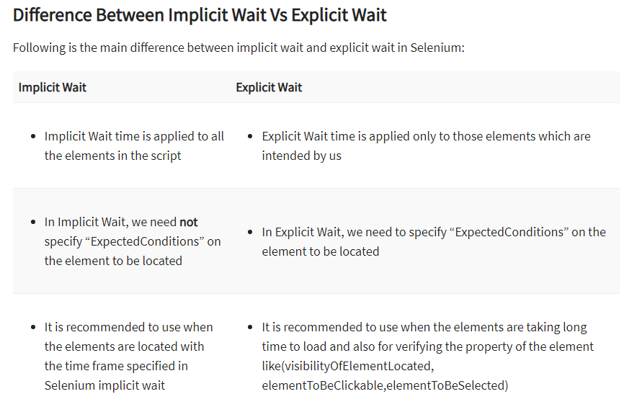

Slide 6
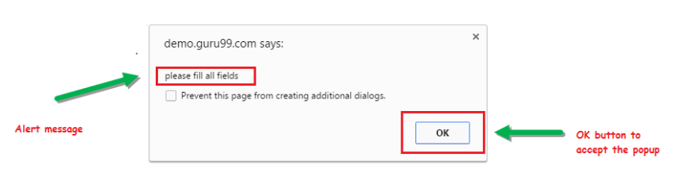
Use blow link for alert pop up handling
https://demo.guru99.com/test/delete_customer.php
What is Alert in Selenium?
An Alert in Selenium is a small message box which appears on screen to give the user some information or notification. It notifies the user with some specific information or error, asks for permission to perform certain tasks and it also provides warning messages as well.
1) Simple Alert
The simple alert class in Selenium displays some information or warning on the screen.

Slide 7
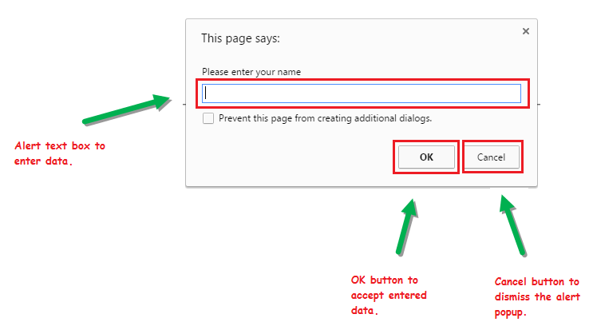
2) Prompt Alert.
This Prompt Alert asks some input from the user and Selenium webdriver can enter the text using sendkeys(” input…. “).

Slide 8
How to handle Alert in Selenium WebDriver
Alert interface provides the below few methods which are widely used in Selenium Webdriver.
1) void dismiss() // To click on the ‘Cancel’ button of the alert.
driver.switchTo().alert().dismiss();
2) void accept() // To click on the ‘OK’ button of the alert.
driver.switchTo().alert().accept();
3) String getText() // To capture the alert message.
driver.switchTo().alert().getText();
4) void sendKeys(String stringToSend) // To send some data to alert box.
driver.switchTo().alert().sendKeys("Text");
Example -
driver.get("https://demoqa.com/alerts");
driver.findElement(By.id("alertButton")).click();
driver.findElement(By.id("confirmButton")).click();;
Alert alrte = driver.switchTo().alert();
String alertMessage= driver.switchTo().alert().getText();
System.out.println(alertMessage);
alrte.accept();

Slide 9
driver.close() and driver.quit() are two methods for closing a browser session in Selenium WebDriver. It is necessary to know when to use each method in a test script.
driver.close() closes only the current window on which Selenium is running automated tests. The WebDriver session, however, remains active.
On the other hand, the driver.quit() method closes all browser windows and ends the WebDriver session.

Slide 10
How to Scroll Down or Up using Selenium Webdriver
A Scroll is a JavaScript method. The JavaScriptExecutor provides an interface that enables QAs to run JavaScript methods from Selenium scripts. Hence, to scroll up or down with Selenium, a JavaScriptExecutor is a must.
JavascriptExecutor js = (JavascriptExecutor) driver;
js.executeScript("window.scrollBy(0,250)", "");
The scrollBy() method involves two parameters, x, and y, that represent the horizontal and vertical pixel values, respectively.

Slide 11
driver.get("https://www.amazon.in/?&ext_vrnc=hi&tag=googhydrabk1-21&ref=pd_sl_7hz2t19t5c_e&adgrpid=58355126069&hvpone=&hvptwo=&hvadid=486386870127&hvpos=&hvnetw=g&hvrand=10448083105448026659&hvqmt=e&hvdev=c&hvdvcmdl=&hvlocint=&hvlocphy=9040233&hvtargid=kwd-10573980&hydadcr=14453_2154373&gclid=CjwKCAiAx8KQBhAGEiwAD3EiPxRagt-YlVXvJj_Fqbj8rE_KjnnoIoChoMvB1Mz2Zu2QN6qIMgLc8RoCNQsQAvD_BwE");
JavascriptExecutor js = (JavascriptExecutor) driver;
js.executeScript("window.scrollBy(0,1000)");
Thread.sleep(10000);
js.executeScript("window.scrollBy(0,-1000)");
Thread.sleep(10000);

Slide 12
How to scroll down to an element in Selenium until it is visible
//Launch the application
driver.get("https://www.browserstack.com/guide/selenium-scroll-tutorial");
//Locating element by link text and store in variable "Element"
WebElement Element = driver.findElement(By.linkText("Try Selenium Testing For Free"));
// Scrolling down the page till the element is found
js.executeScript("arguments[0].scrollIntoView();", Element);

